Slide 1
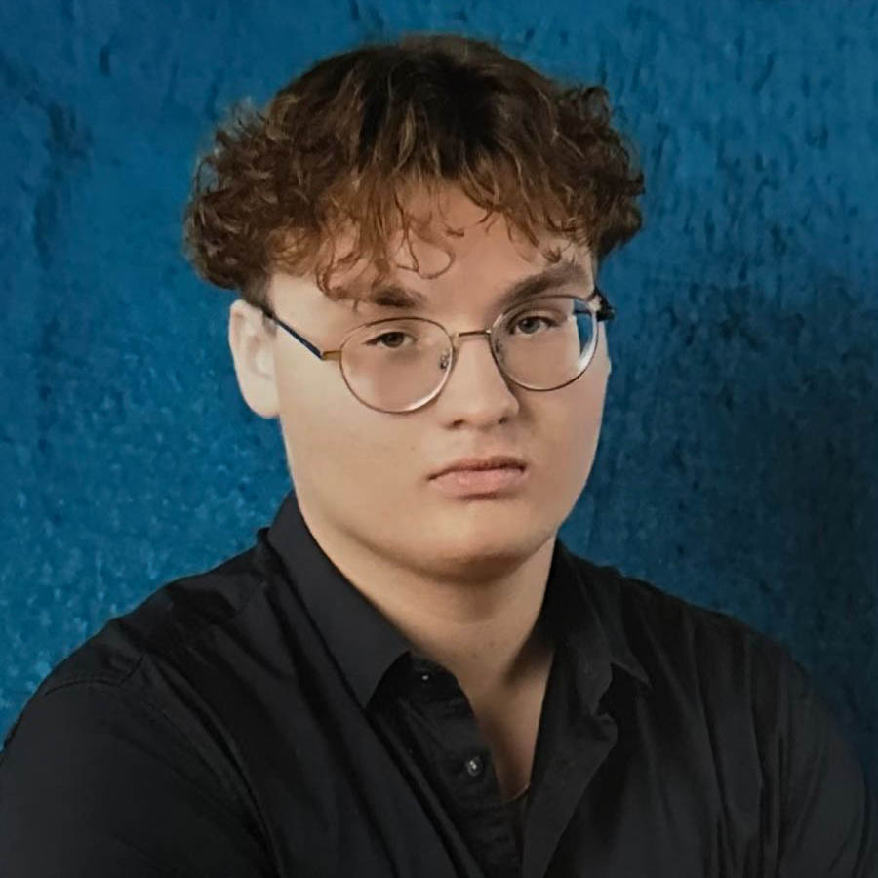
«Džastins Markuss Krauze»
«Student ID: 252655»
DESIGN &
PRODUCTION
CMGT Intake
2025-26

Slide 2
Section A
A
Education Information

Slide 3

A
(A1) Education information
A
Current education level:
Babītes Vidusskola/Babītes Secendery school.

Slide 4
Section B
B
Assignment

Slide 5
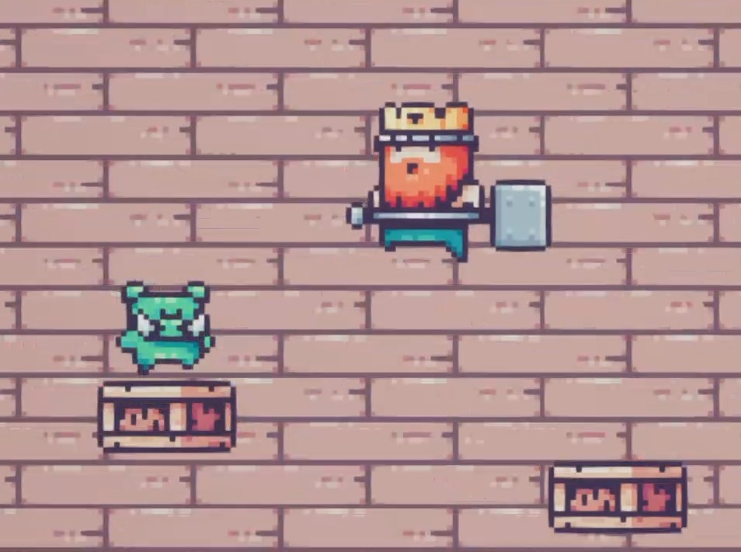
B
Part One - Creating a game
My Game Idea
My game is a 2D side-scroller where the main goal is to reach the top of the tower,
avoiding obstacles such as falling platforms and moving enemies. The core
gameplay loop consists of fun and challenging platforming and finding ways
to finish the game faster.
In the beginning of the project, the only goal was to reach the top of the tower.
Later on, I added additional goals such as collecting coins to gather a score while
climbing. For the creation of this game, I used Unreal Engine 5 and watched
tutorials from Cobra Code YouTube videos and video courses. The free assets
were acquired from the itch.io free assets section.
My main mechanics included controlling the character with "A" and "D" / left and
right arrow keys, and jumping using the spacebar. Later, I added mechanics
such as coyote time and the ability to jump higher by holding the spacebar.
To give a sense of progression, I added a scoreboard.

Slide 6
B
Part Two - Testing and iteration
Testing and Questionnaire
After I had tested my game, I ran a test with my target audience, by sending out the first version of the game with a questionnaire.
These were the main questions I focused on:
What would you suggest to improve or add to the game?
Was the goal or objective of the game clear to you?
What do you think of the design of the game?
Google survey

Slide 7
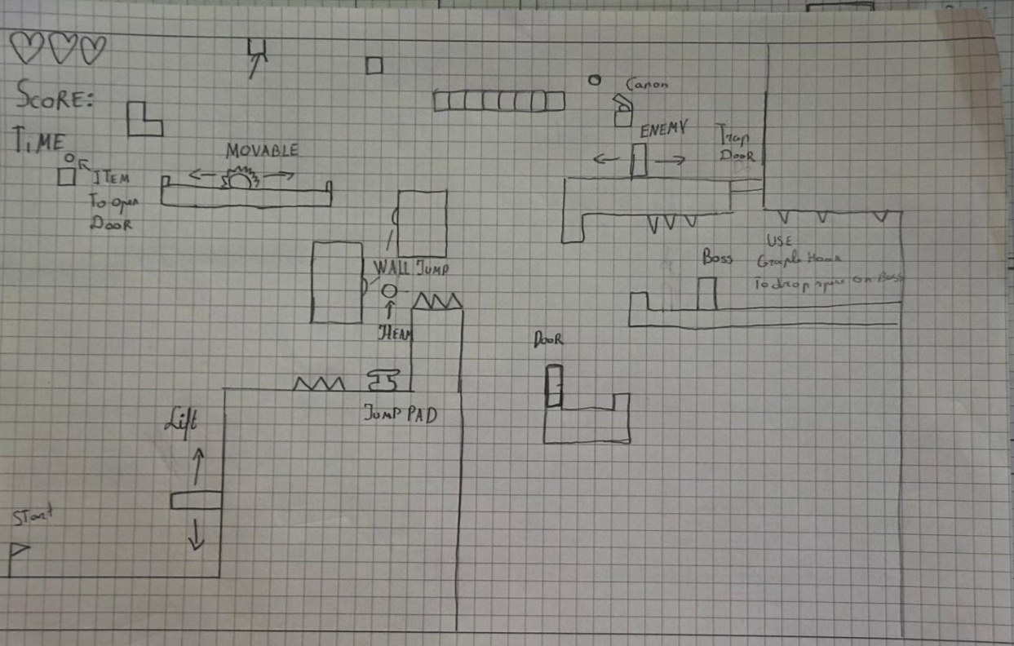
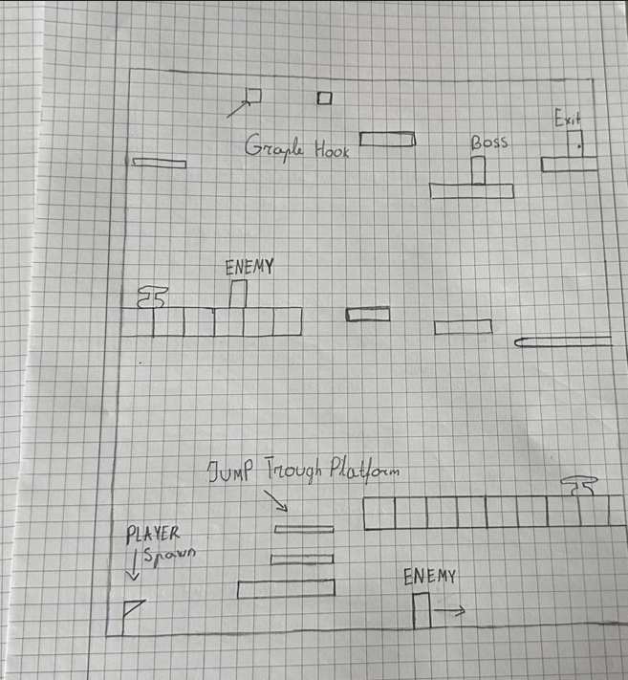
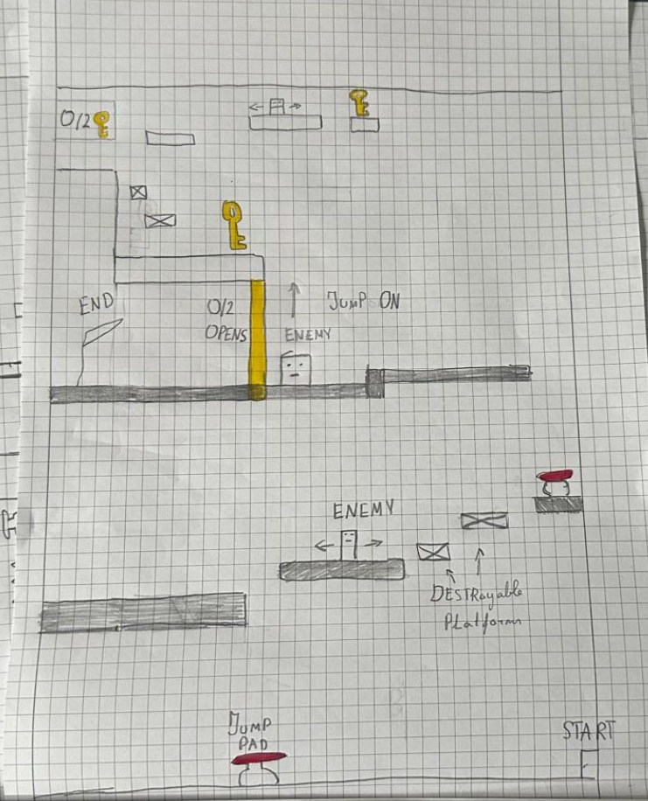
B
(B2) Design and Production Assignment - Creating a game
Title: TowerKing
Description:
TowerKing is a 2D side-scroller where the main objective is to reach the top of a towering structure. Players must avoid obstacles such as falling platforms and moving enemies. The core gameplay loop focuses on fun, challenging platforming and encourages players to find faster, more efficient routes to complete the game.
In the first image, the player must collect two keys while dodging enemies and using jump pads to unlock a wall and reach the exit.
The second image depicts a level where you need to use the lift to go up after reaching the top of the platform player has to avoiding obstacles by using grapple hook to get an item to opens the door after defeating the boss using grapple hook to throw spikes on him.
Last image depicts a level similar to my intake project were the players goal is reaching the top of the tower avoiding obstacles such as falling platforms and moving enemies.

Slide 8
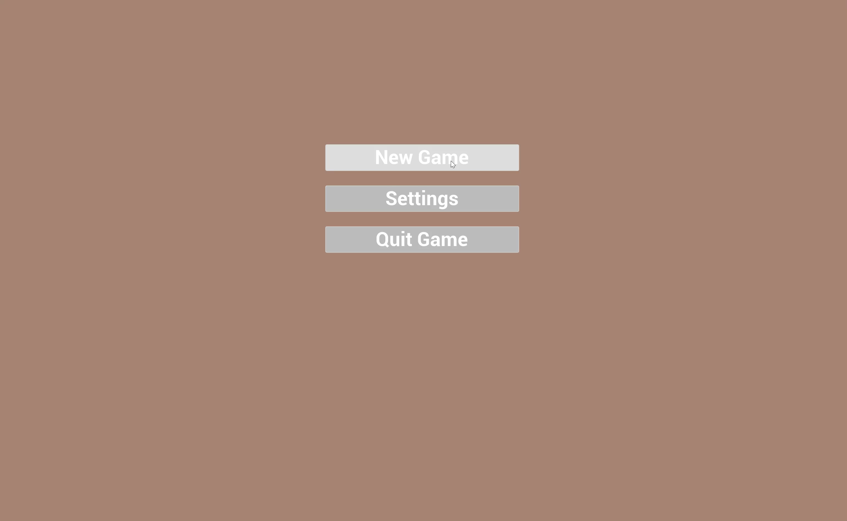
B
(B3) 3 important design decisions
Coyote Time
I added this mechanic to improve the playability of my game, in which the player for a short moment has time after stepping off the platform, to press the jump button to reach the next platform making traversing of the map feel more forgiving and enjoyable.
Key collection as a gate mechanic
This mechanic requires the player to explore the level and collect a specific number of keys to progress by opening the door. It encourages exploration and adds a layer of purpose to reaching the end goal.
The video is a showcase of my game level in which you need to travers the level to reach the ending.
One-way jumping platform and falling platforms.
One-way and falling platforms enhance the level of my game by adding movement based challenges. One-way platforms allow the player to pass through from below and land on top of the platform, while falling platforms disappear shortly after contact, making time- sensitive decisions before falling more challenging for traversing the level.

Slide 9
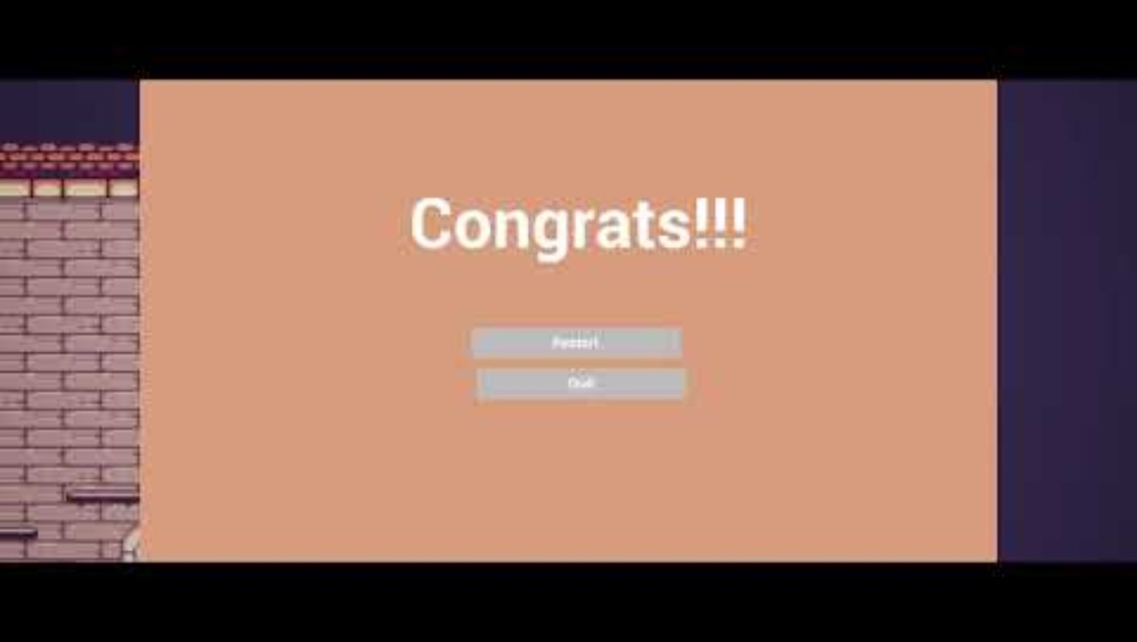
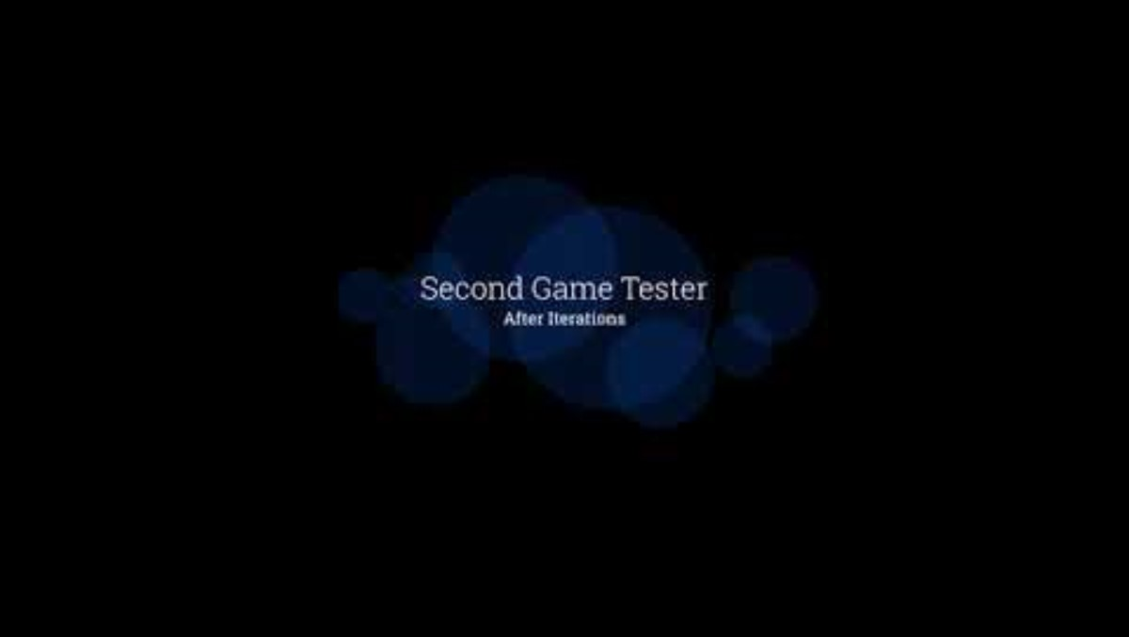
(B4) Short video of play-tester of the intended target audience playing my game.
B

Slide 10
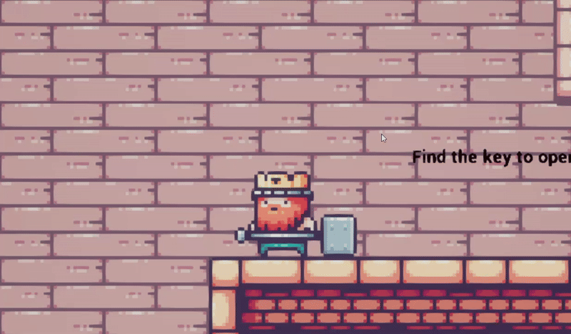
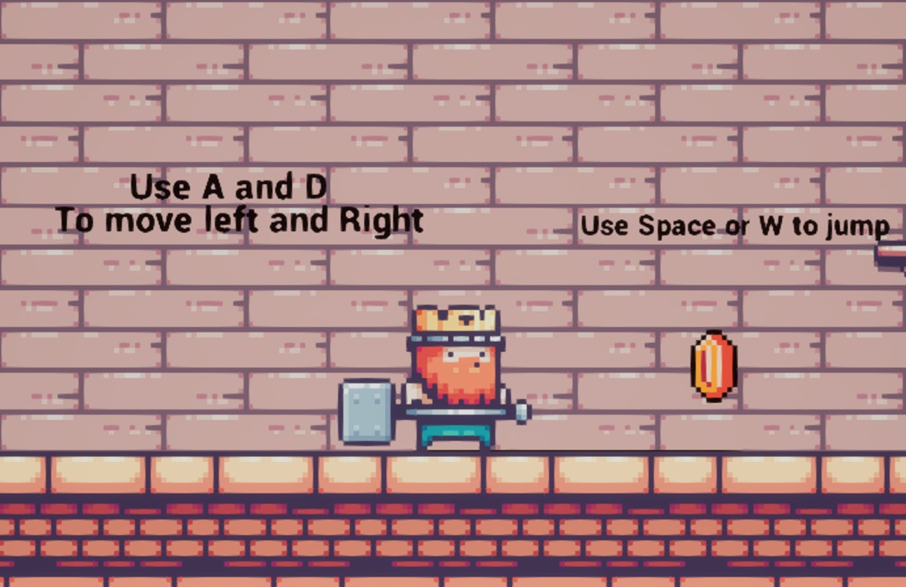
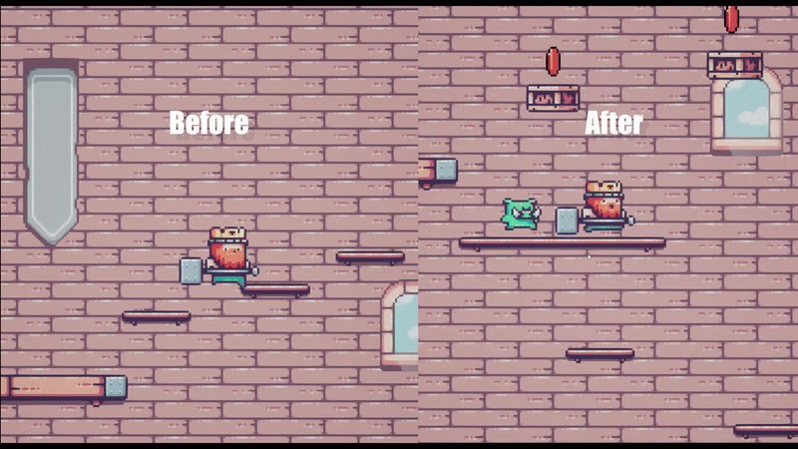
B
(B4) Design and Production Assignment - Testing and Iterating
First suggestion was to improve the feel of jumping and to add collectibles.To imploment this suggestion I added the ability to control the height of the jump while holding the spacebar, letting the player to do either
quick small jumps or long jumps.
Second suggestion was to add descriptons where the player can understand the controls of the game and give some tips on defeating the enemies and finishing the level. For this I added texts on the walls that describe basic controls and the objective of the game. In addition I added scoring system that appears in the corner of the window.
After the survey, testers wanted improvments on the level design wanting to minimalize platforme quantity and making it more esteticly plesent than before and switching regular platforms to falling platforms making the game more chalanging.

Slide 11
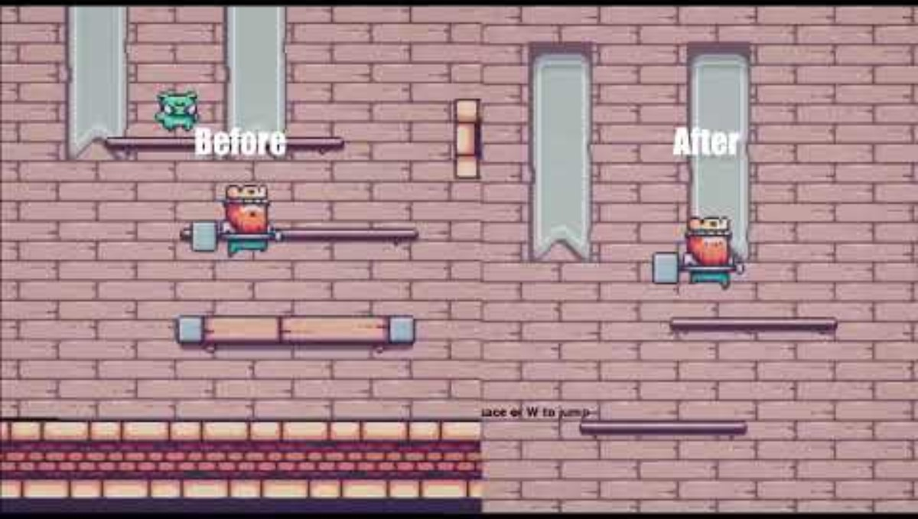
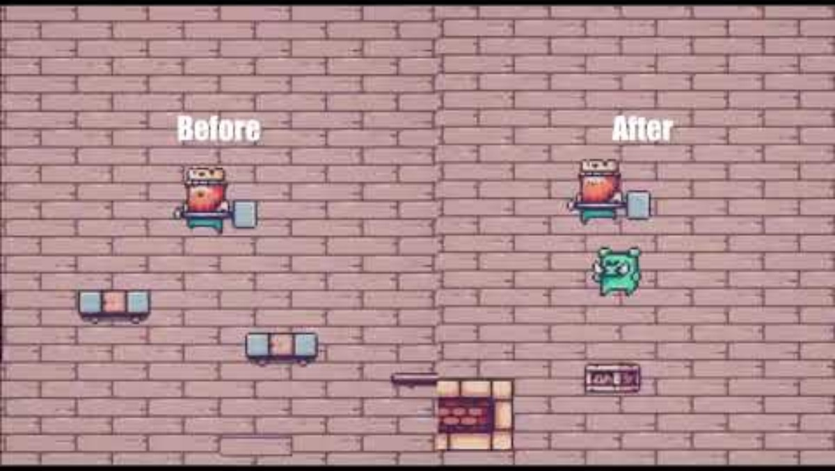
B
(B5) Design and Production Assignment - Testing and Iterating

Slide 12
B
(B6) Relevant Portfolio, Skills & Knowledge
Currently, I do not have a Portfolio or previous game developer experience. All my best work can be seen in this presentation. During the last two months, I've been learning from online sources to improve my knowledge of Unreal Engine 5 and coding. I'm dedicated to learning and gaining more experience in person.

Slide 13
Refrences
These are the tutorials and assets I used for my intake.
2D Enemy AI in Unreal Engine 5 - Beginner Tutorial
Cobra Core Courses (Includes most of the game assets)
Key asset
coin asset

Slide 14

End of Presentation
IMPORTANT:
Before uploading to ’My Online Application’ please rename this document using the following naming convention:
firstname_familyname_studentnumber_intake_2025-26.ppt
Thank you for participating in the intake for
CMGT Games @ Breda University of Applied Sciences

