Slide 1
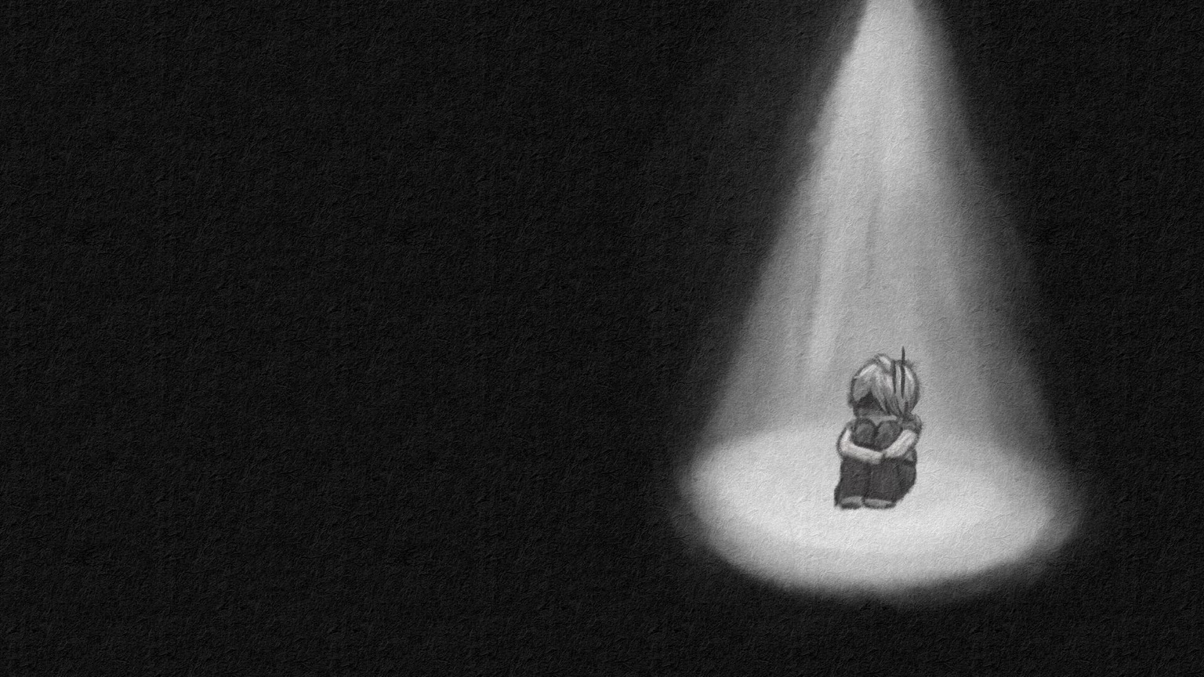
Light The Way
Art Bible

Slide 2
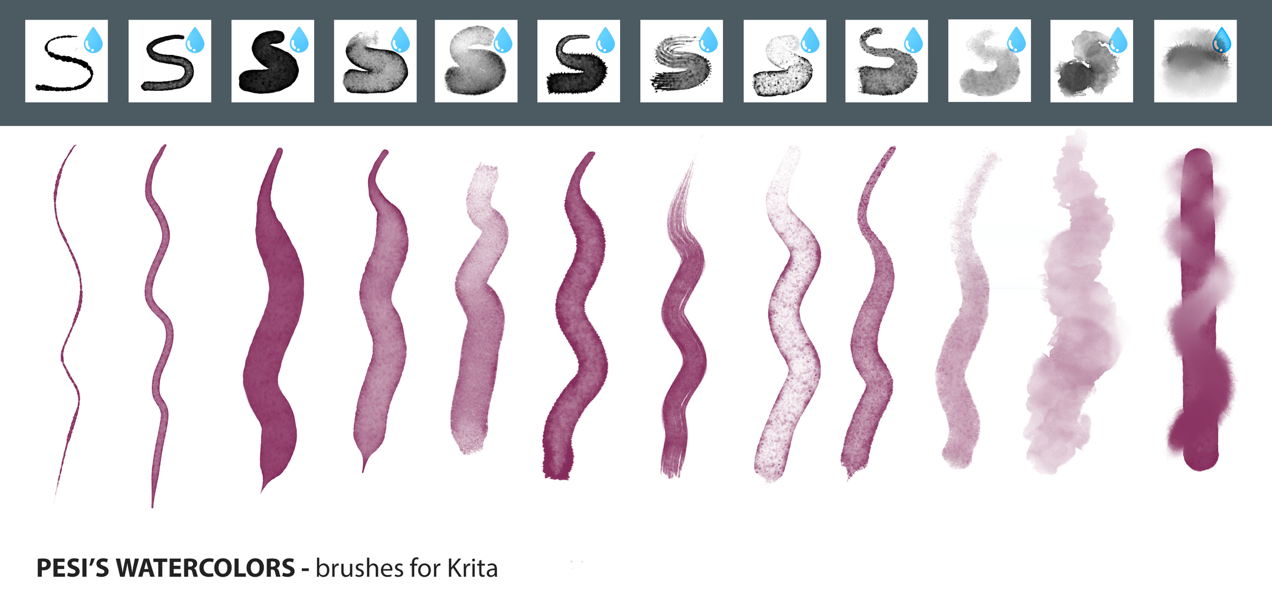
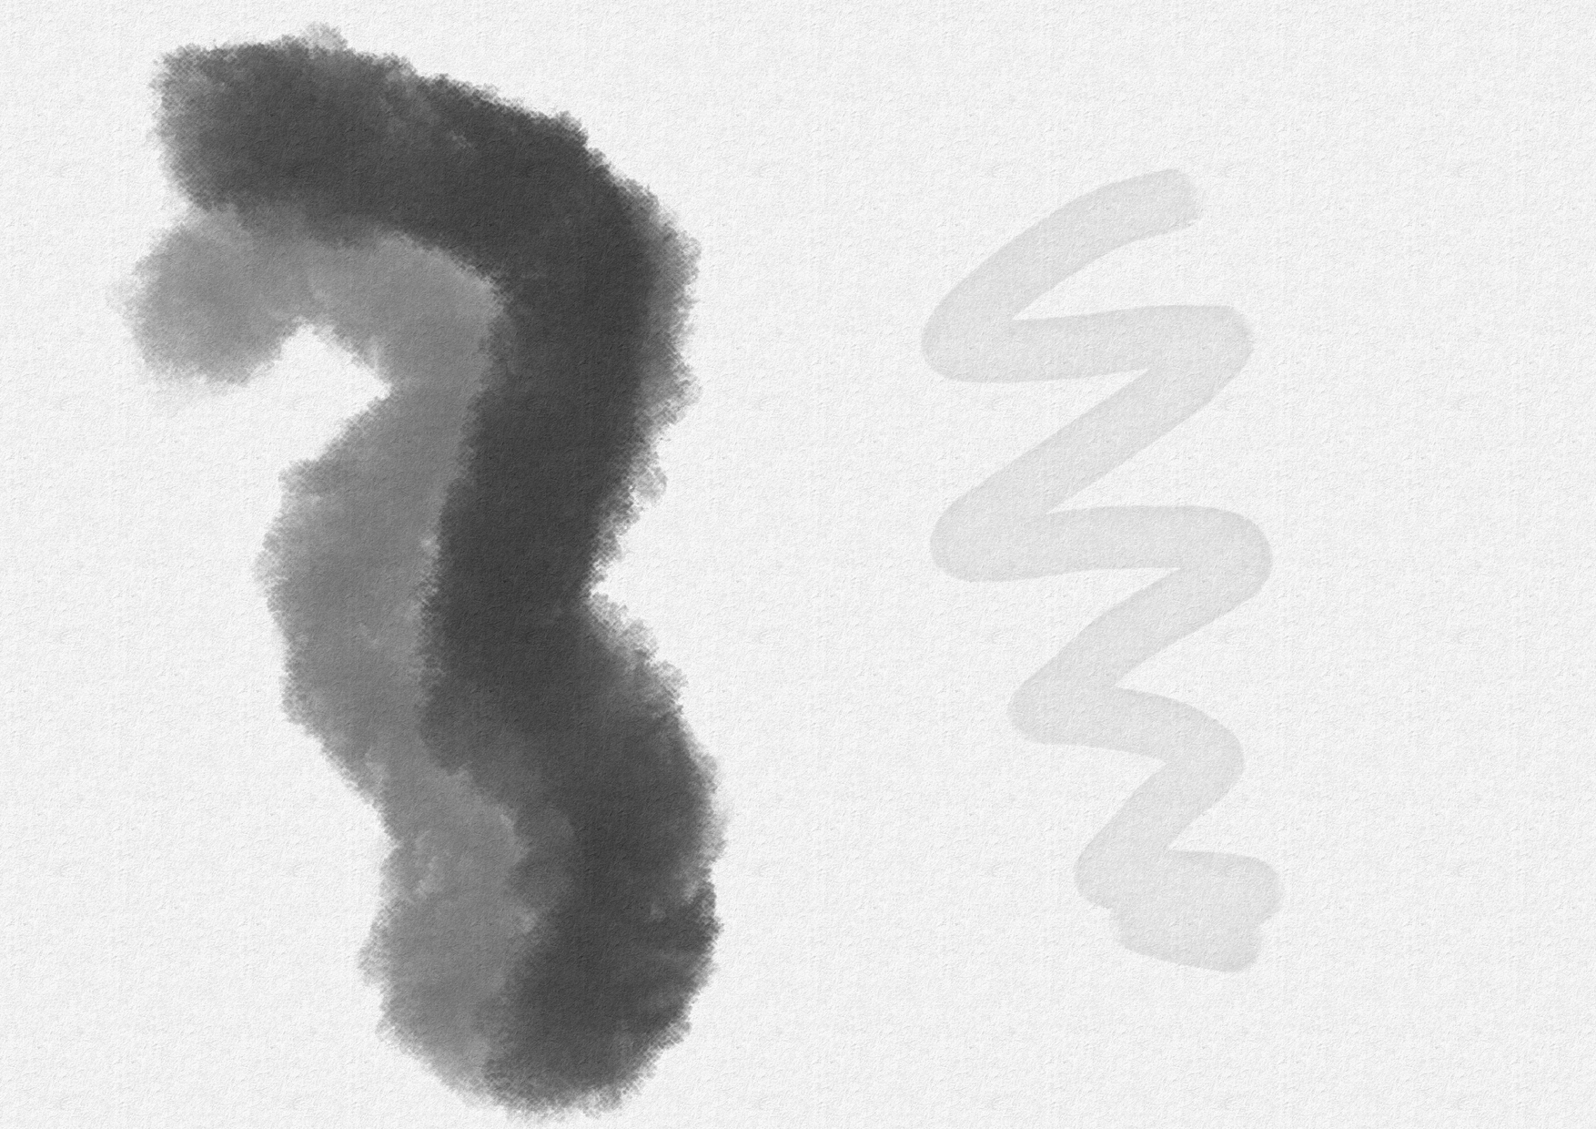
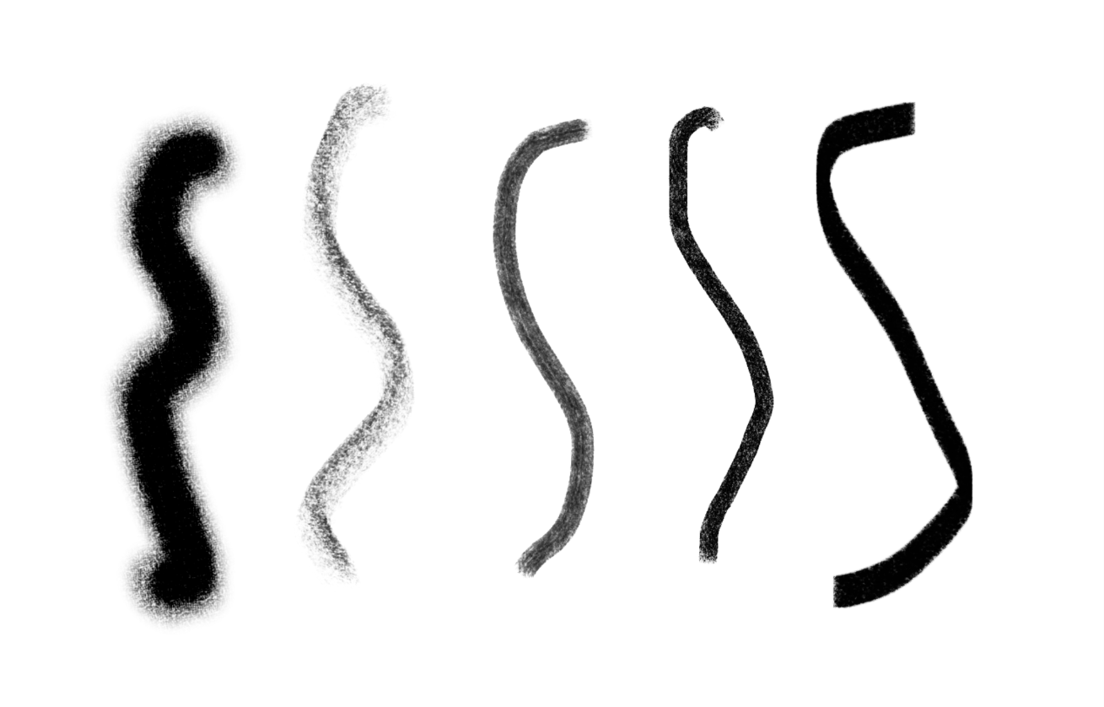
Used brushes and textures
The game art is very texture focused since it emulates hand drawn styles. The cave backround is drawn on a specific watercolor backround so it would give the art a more realaistic touch like real watercolors and it uses special watercolor brushes as well.
The main charachter any other object is draw on regular paper in krita but using charcoal pencil like brushes so it would better give off the hand drawn sketched style.
Watercolor paper:
Watercolor brushes:
Charcoal pencil brushes

Slide 3
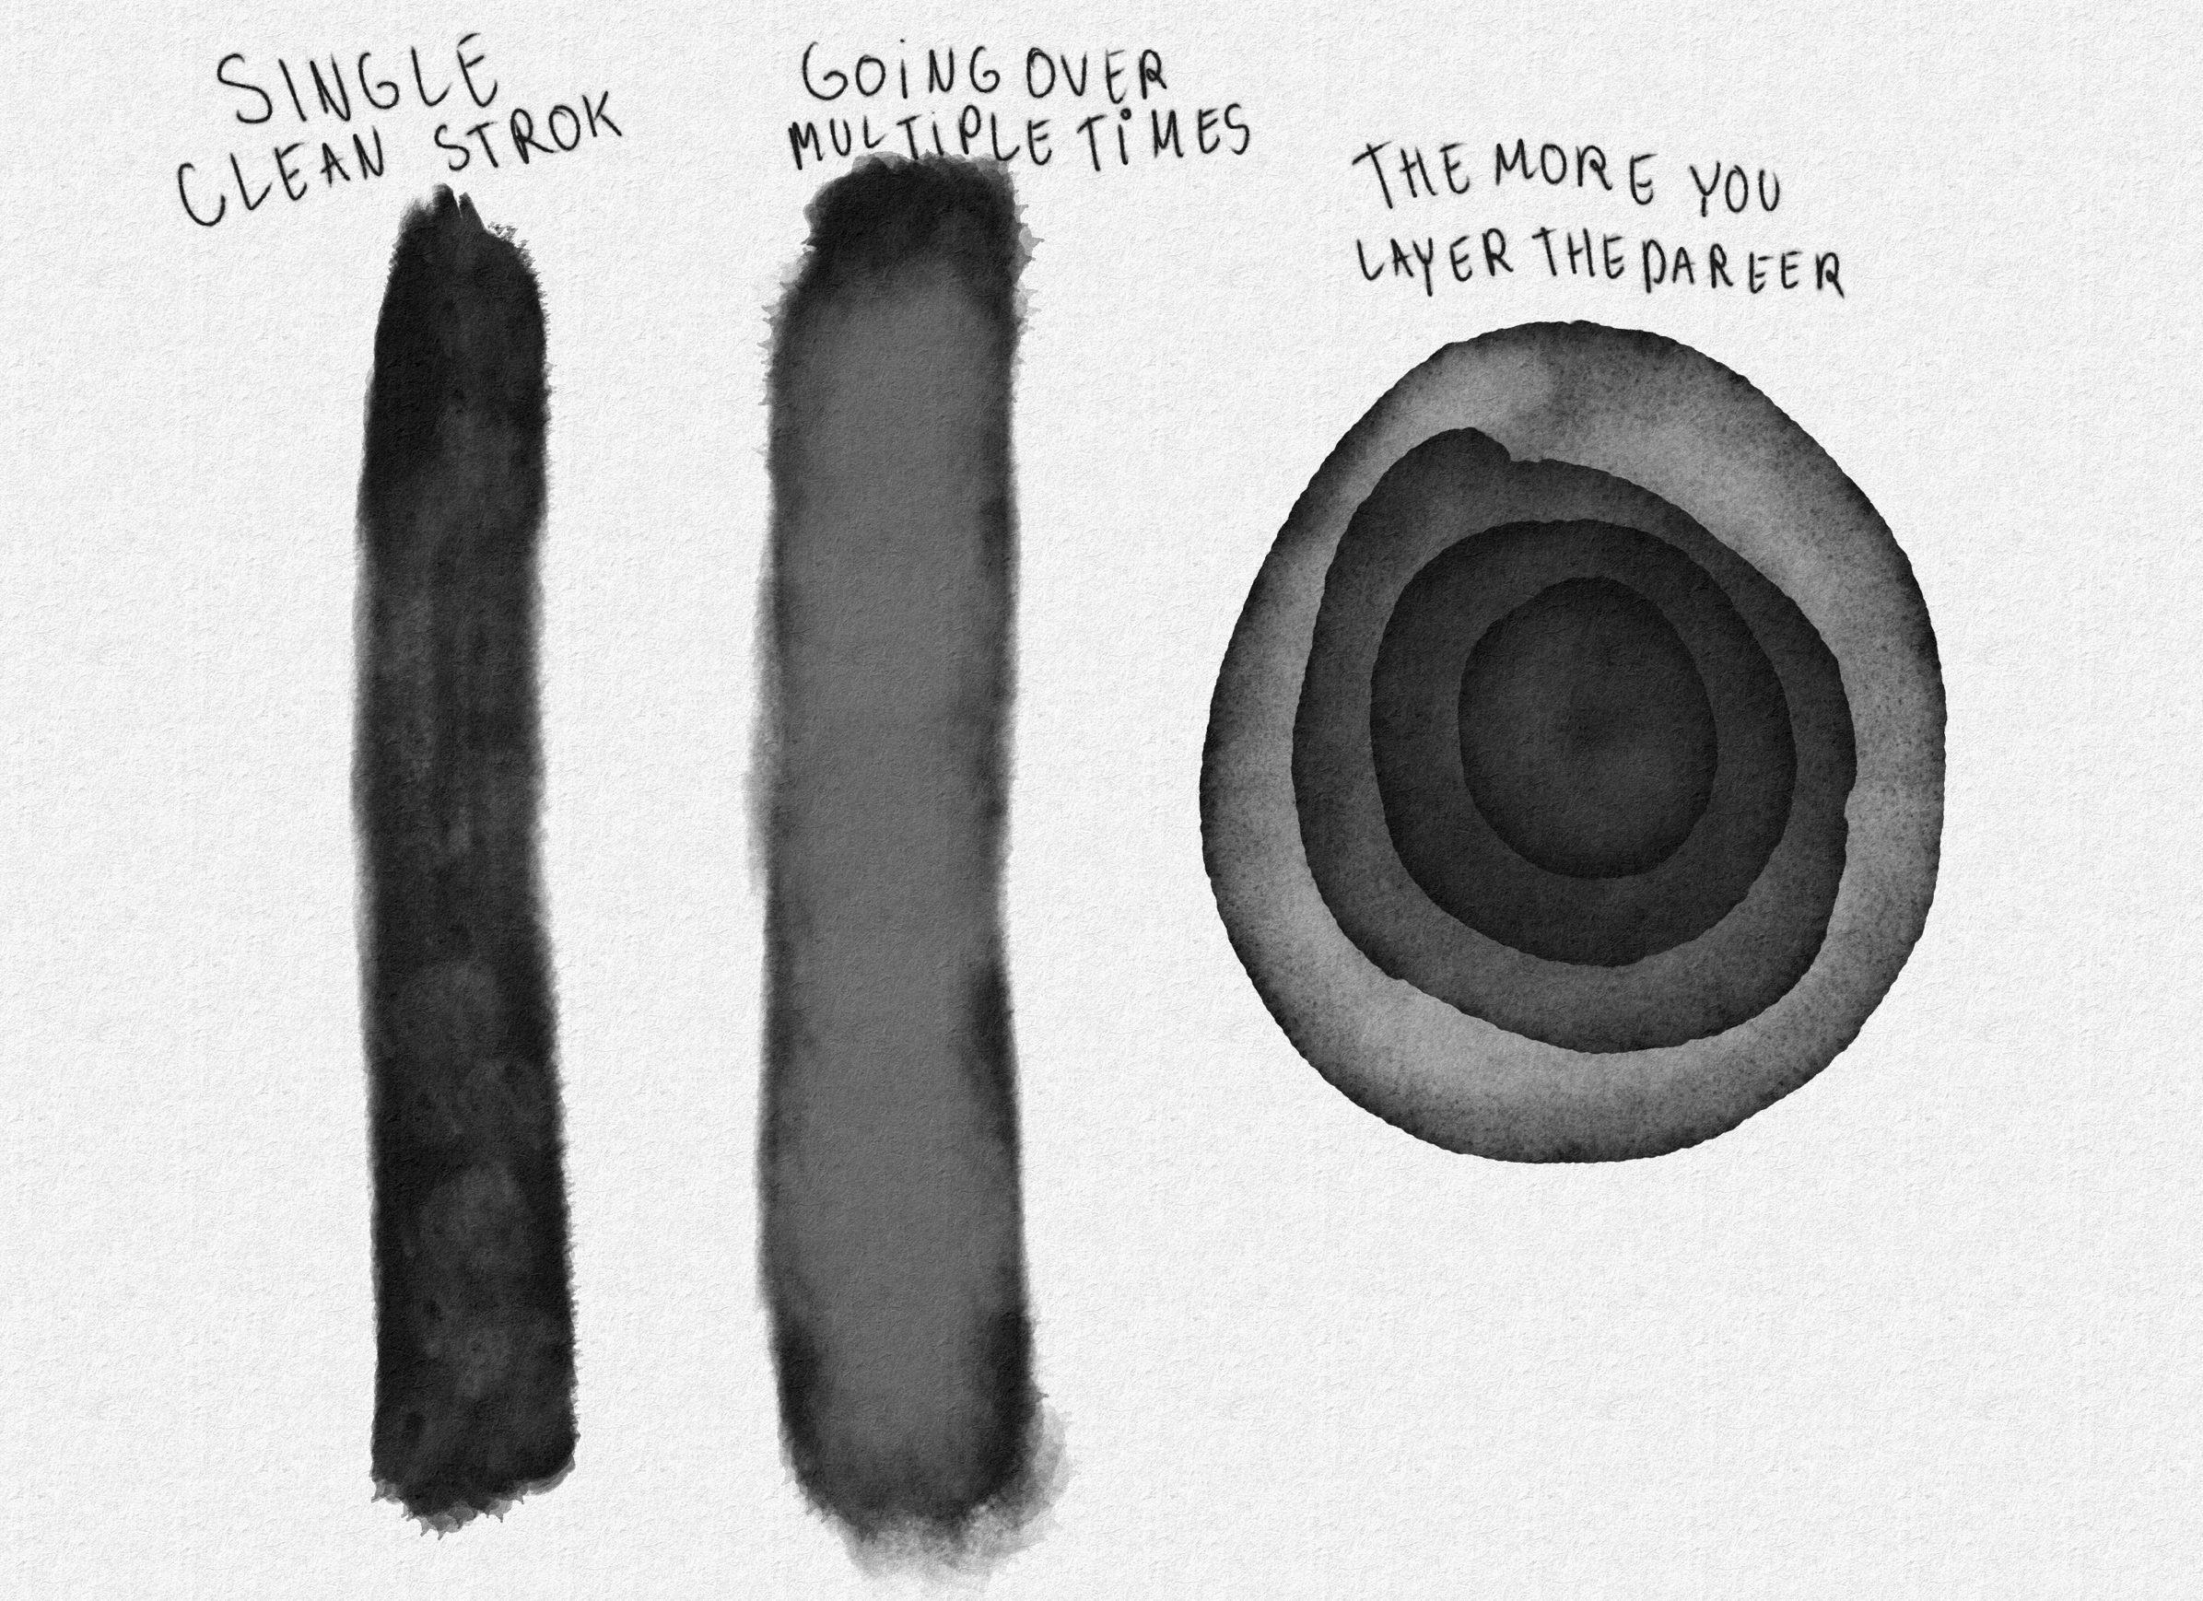
Brush tehnique guide for the backrounds
Drawing the backrounnd with watercolor brushes can take a bit to get used to due to them being quite unique.
When staring out withe backround it’s good to block out a neutural value of gray on a separate layer so it’s easier to get the hang of other values. The watercolor brushes aren’t very opaque and the more you go over an area with the same stroke the less opaque it will be. So when drawing things it’s best to do it in a clean single stroke afterwards going in with more strokes letting the color layer on top of it better. Similar to real life watercolors adding lighter colors like white ontop of a dark one won’t really do much so it’s best to either block out the light and dark spots ahead of time or utilize the fact that the more you layer the less opaque it will be an dput some ligjhter spots on in a diffirent layer on top letting some of the lighter color blend in with wthat’s in the layer behind in the backround.

Slide 4
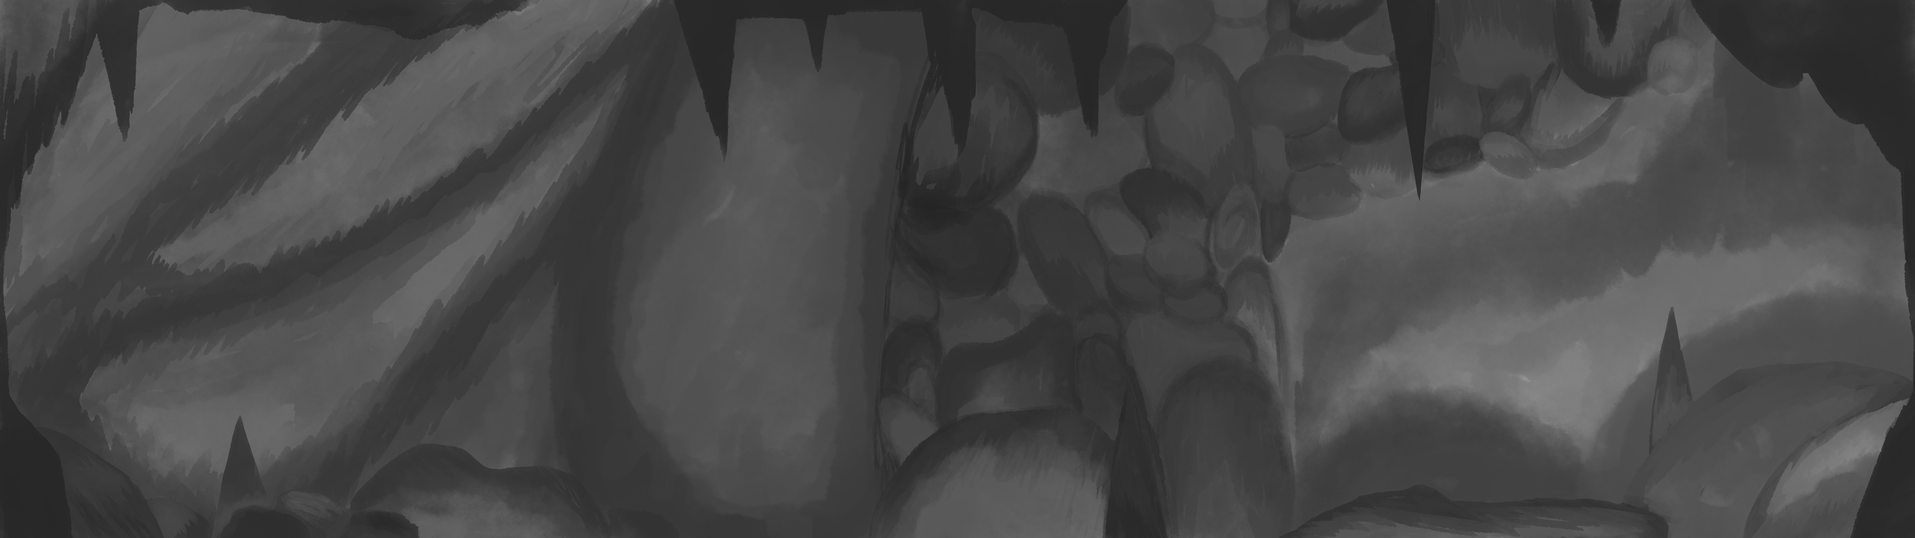
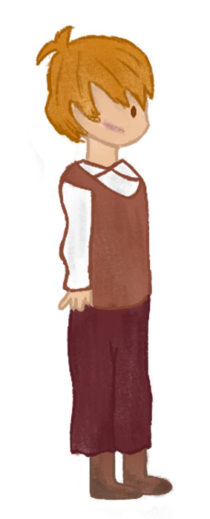
Art Style
The art style is based on a hand drawn style. Incorporating both a watercolor style and a sketched style. All game art besides the main character are drawn in grayscale.

Slide 5
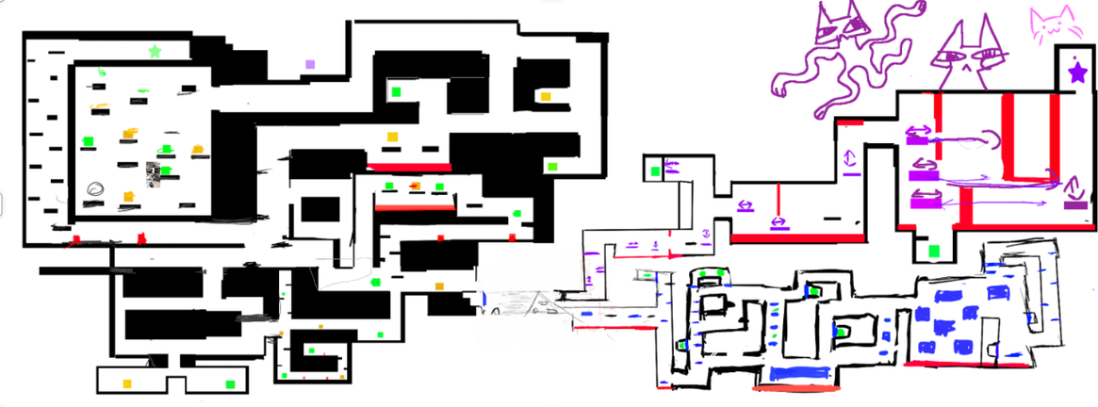
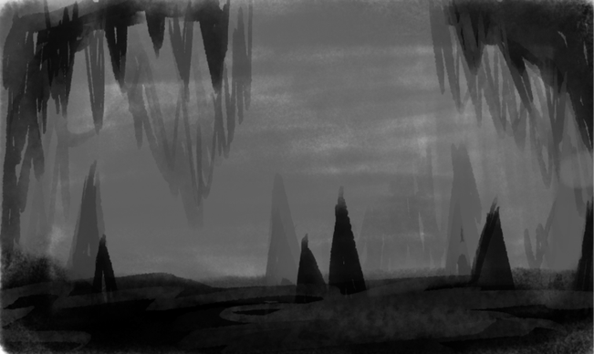
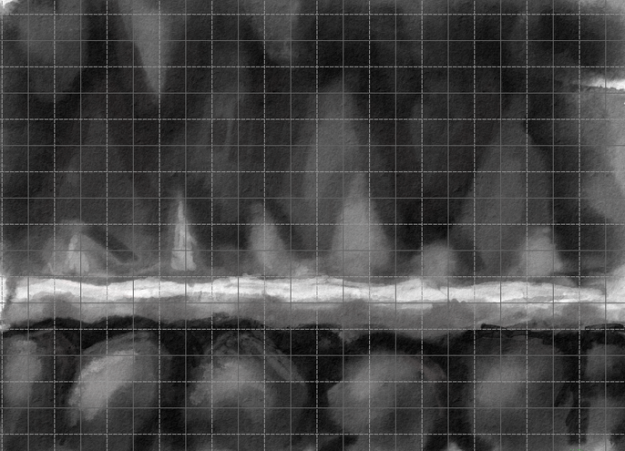
Area design and Atmosphere
The background are drawn fully in a watercolor style. The background being a bit darker than the foreground and also having a more softer blurry look than the sharper and more detailed foreground
The game is devided into 3 destinct areas. The area with moving platforms being very dangerous based on a stalagmite cave focused on triangles and very sharp shapes representng a very dangerous and action fuled atmosphere.

Slide 6
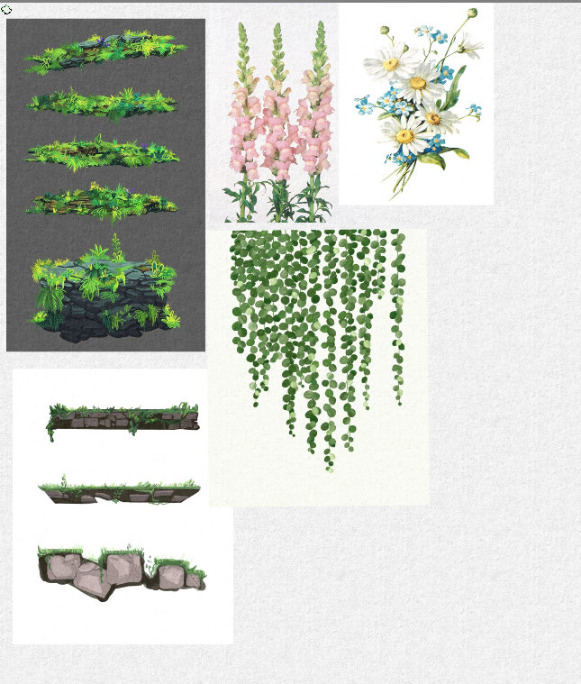
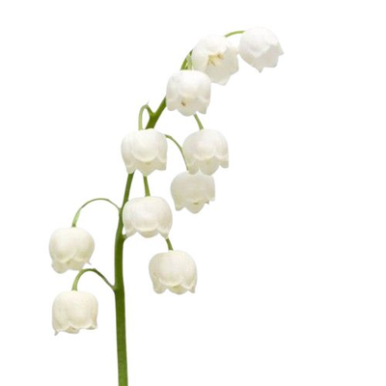
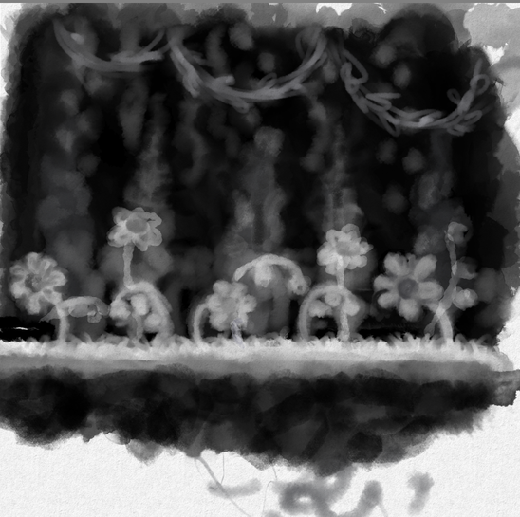
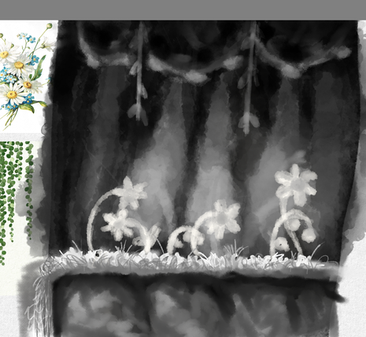
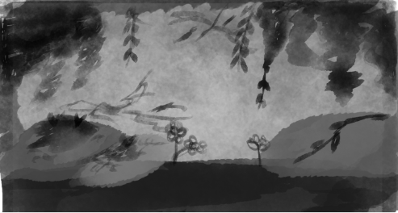
Area design and Atmosphere
The area with disappearing platforms is very alive and overgrown with plant life based on very round circle liek shapes, representing feelings of peace and harmony this part of the cave has a more calm and alive atmosphere. The cave is overgrown with plant life such as vines, moss, daisies, snapdragons, lily of the valley since most of these plants have a very distinct shape that is recognizable.

Slide 7
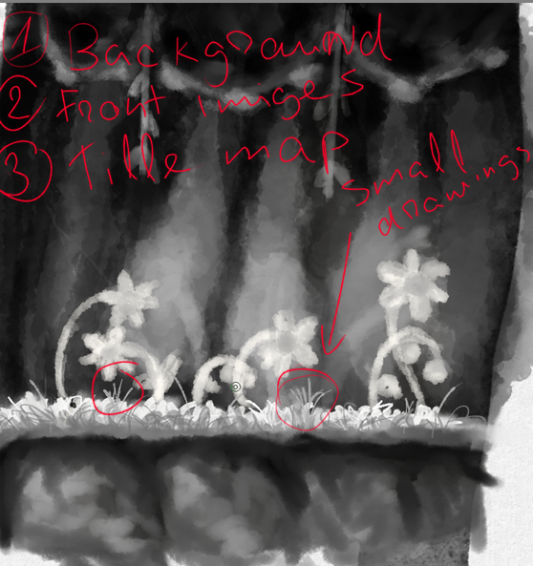
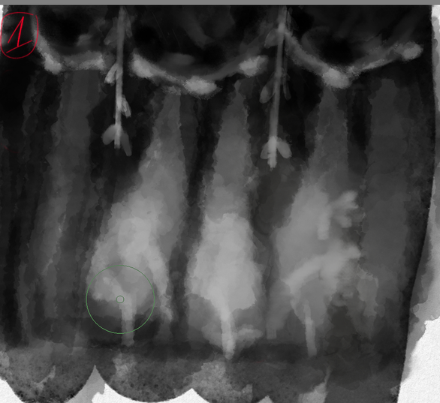
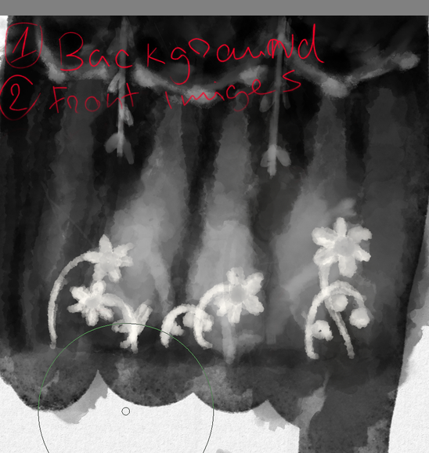
Area design and Atmosphere
Background

Slide 8
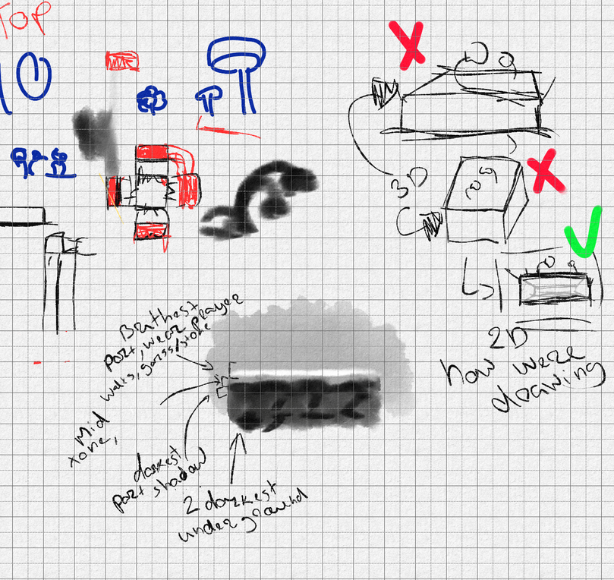
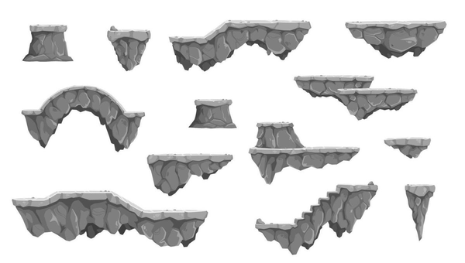
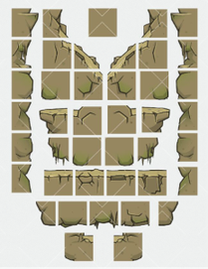
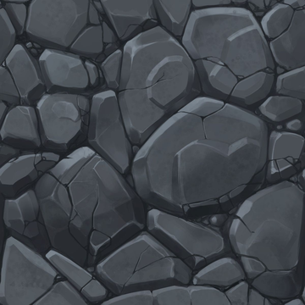
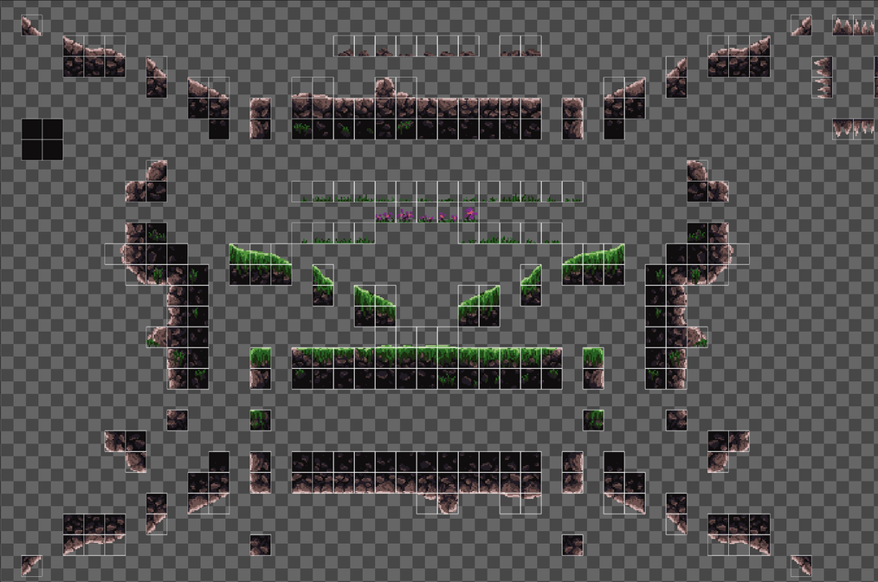
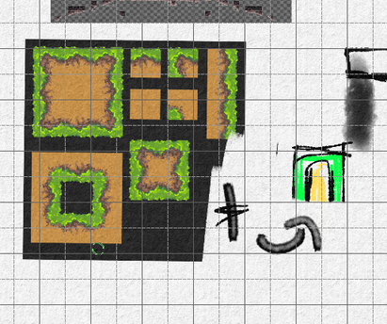
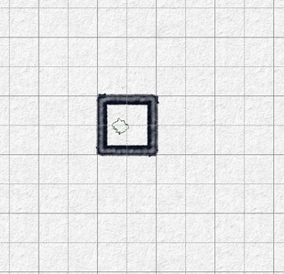
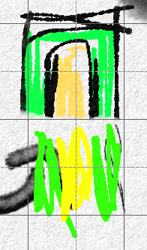
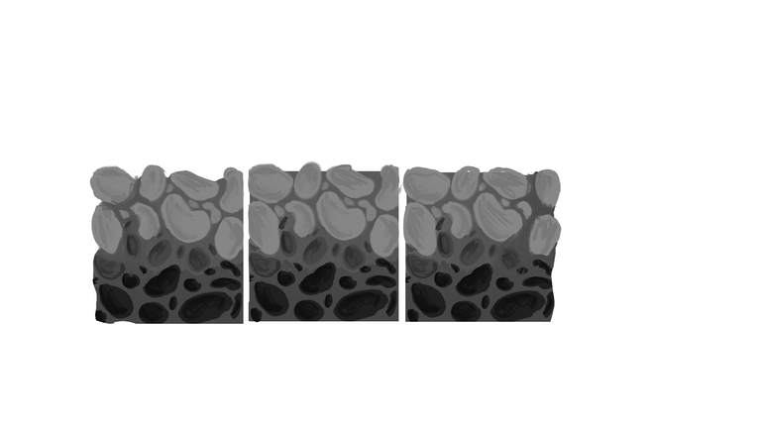
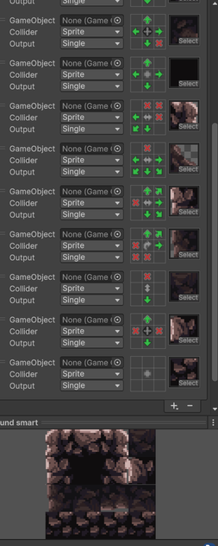
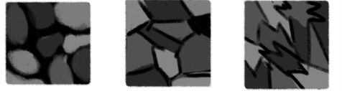
The tile maps style will consist of the tyles top where the player walks on being lighter and underneeth having a small dark area to represnet a shadow and underneeth that a bunch of rocks/rubble the later tiles undetneeth will be a lot darker with less detail.
Tile Map

Slide 9
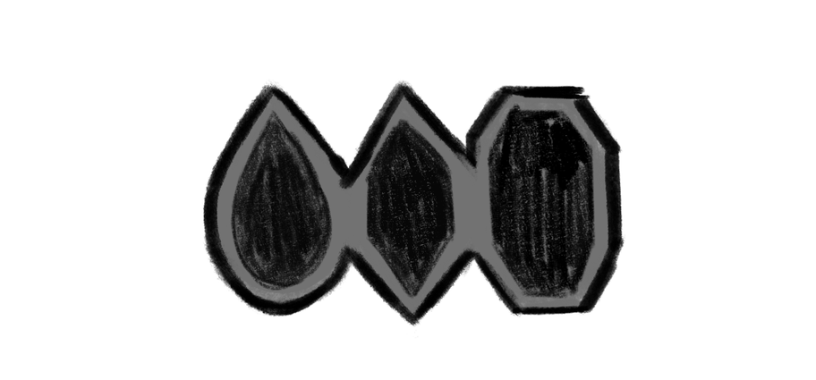
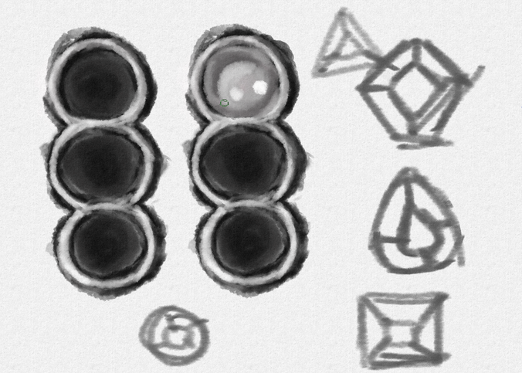
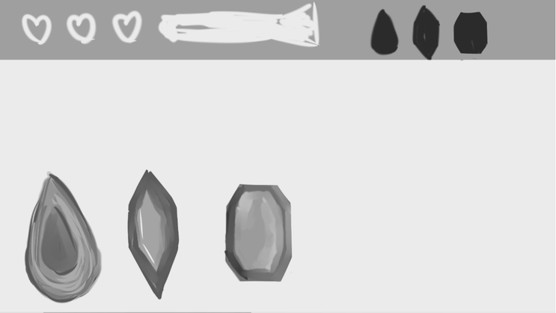
UI layout
The UI is located on the very top of the game screen, showcasing a flashlight that indicates how much power is left until the light runs out. 3 hearts that represents how many lives the player has as well 3 grayed out slots that become full when the player coolest each crystal gem.

Slide 10
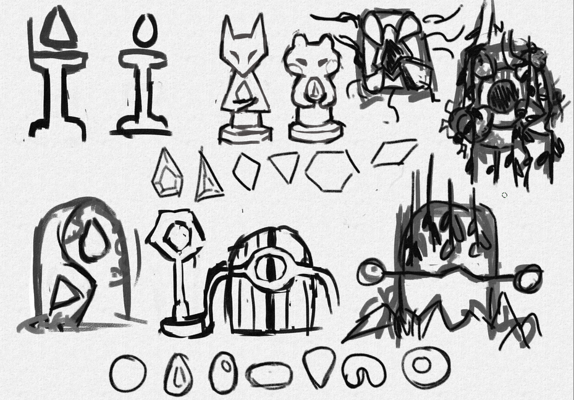
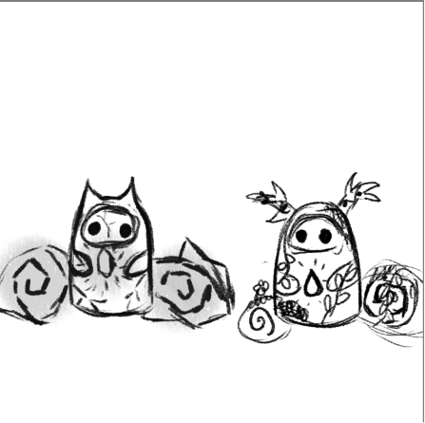
Artifact statues
The artifact statues will be round based on some animal like detures like ears or horns holding a liitle gem artifact that the player can then collect. The player afterwards will have a door where each of the artifacts can be placed to open.

Slide 11
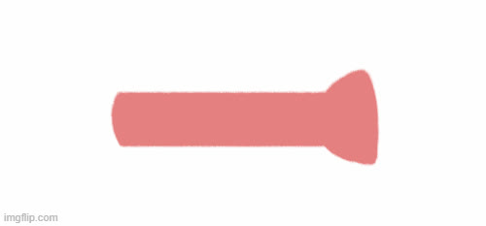

Effects
When the flashlight bar starts running out it becomes red in the UI to signify to the player better that they're running out of energy. When a player collects a gem the UI shines a little sparkling animation as well as the gem slot filling up.

Slide 12
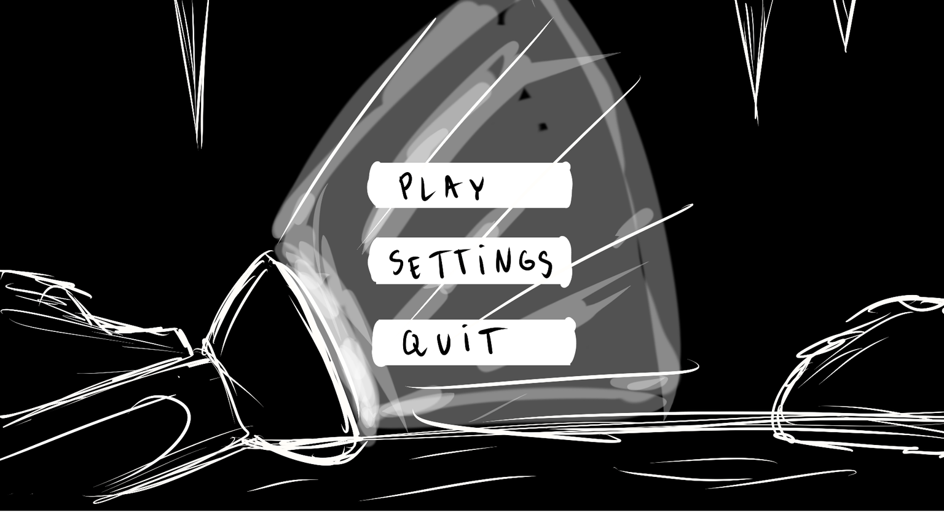
Title Screen
The titel screen has a flashlight that illuminates the main buttons and the game title and features a simple cave backround nehind it.

